Slide 1


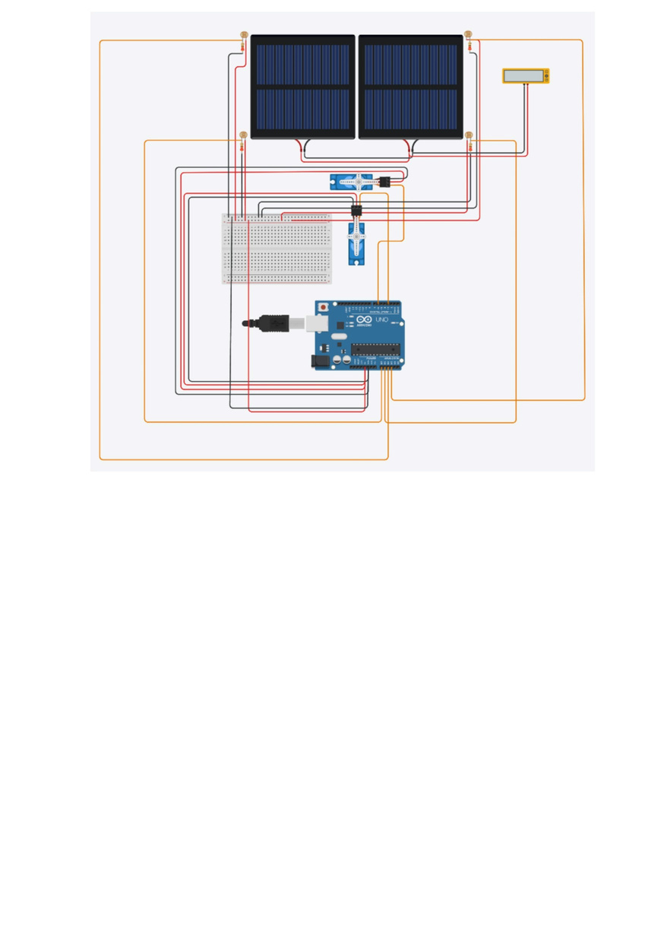
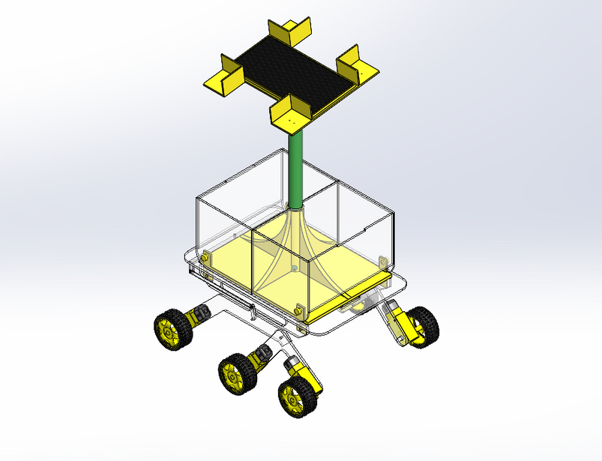
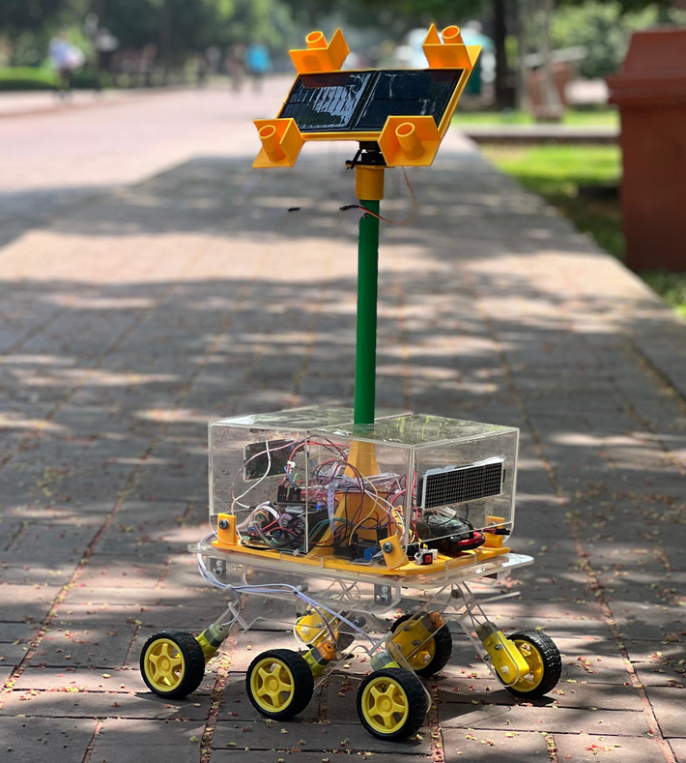
Solar Tracking with Solar Panel
Group
ME
09
R. Mahmud (210011285), A. H. Neloy (210011225), J. U. Khan (210011269), M. R. Adrit (210011271), R. H. Rohid (210011273), M. R. Joutha (210011275), R. Alam (210011283)
MIC LAB (ME- 4408) | Academic Year: 2023-24
INTRODUCTION
METHODOLOGY
RESULTS & DISCUSSION
One promising advancement in solar energy systems is the implementation of solar tracking systems, where solar panels dynamically adjust their position to maximize exposure to sunlight throughout the day[1]. This project aims to explore and develop a solar tracking system that enhances the efficiency of solar panels by optimizing their orientation towards the sun.
Solar tracking involves the automatic alignment of solar panels with the sun's position, allowing them to capture sunlight more effectively and generate higher energy yields[2].
The conventional fixed solar panel systems are limited in their ability to harness sunlight optimally, as the sun's position changes throughout the day.
The Solar Tracking with Solar Panel project leverages technology to create an intelligent and dynamic system that adapts to the sun's movement, thereby increasing energy output [3].
A comprehensive overview of the project’s workflow is illustrated below :
Through continuous adjustment of the solar panel's orientation to face the sun, the system achieved a significant increase in energy output compared to fixed-mount configurations, with a 20-30% improvement observed on average.
There were challenges such as tracking accuracy deviations and environmental factors i.e. the sensor was struggling to operate when there were two sources of light with different intensities.
The initial code was inefficient in running two motors simultaneously. So, the code was further optimized to run both of the motors conveniently.
Through real-time monitoring and data logging, it was observed that the system effectively maintained alignment with the sun's position throughout the day. However, minor deviations and oscillations were occasionally detected, particularly during periods of rapid changes in solar azimuth and elevation angles.
Cloud cover and shading reduced solar irradiance levels, impacting the system's energy output.
While this solar tracking system offers significant benefits in terms of energy efficiency, its implementation involves additional costs and complexities compared to fixed-mount configurations.
One notable advantage of solar tracking systems is their adaptability to various geographic locations and solar irradiance patterns. Whether installed in equatorial regions with consistent sunlight exposure or at higher latitudes with more variable sunlight angles, the tracking mechanism optimizes solar panel orientation to harness the maximum available sunlight, thereby enhancing energy production efficiency across different environments.
Initiation of project
CAD modelling
Developing alternatives
3D printing and manufacturing
Simulation in TinkerCAD
Circuit Assembly
Coding
Error
Testing
OBJECTIVES
Supervisor review
Comments
A solar tracking system that enhances the energy output of solar panels compared to fixed installations.
A robust and reliable tracking mechanism.
minimizing the additional costs associated with the solar tracking system, making it economically viable.
A design that minimizes material usage, energy consumption, and waste generation.
Project Complete
SCHEMATIC DIAGRAMS
Fig 3. Circuit diagram of the project in TinkerCAD
Further Development and Improvisation
The circuit contains 2x Micro MG90S 180-degree servo motors for the solar panel movement as well as 4x Light-Depending Resistors (LDR) as the primary sensors for the system. The servo motors and LDRs are operated through an Arduino Uno. The LDRs work through voltage divider rule, and the analog values are calculated through the Arduino. Through coding, the analog values are analyzed, and consequently, the servo motors move in the direction of the light source. The system incorporates 2x 5 volt solar panels connected in parallel, and the positive and negative sides of the solar panels are connected in a TP4056 1A Li-ion Lithium Battery Charging Module for the power conversion procedure. The solar energy is converted into electrical energy and stored in a custom-made 3.7-volt lithium-ion battery. The module shows a red LED when exposed to a light source, meaning the batteries are charging through solar panels, and the module will show a blue LED when the battery is fully charged. Also, the real-time voltage generation is shown through a 16x2 I2C LCD display using a voltage sensor.
After the whole mechanical and circuit assembly, continuous calibration is done along with testing and optimization to achieve a satisfactory result.
The solar tracker structure is improvised into a rover system that is a demonstration of solar panels equipped with Mars rovers to generate electrical power for their operations on the Martian surface. In addition to that, a charging mechanism is added to the system that is charged through solar power, and the stored energy can be drawn through USB ports. The system is capable of charging smartphones as well as powering microcontrollers.
Fig 1. CAD model of the project in SOLIDWORKS
REFERENCES
[1]J. Rizk and Y. Chaiko, “Solar Tracking System: More Efficient Use of Solar Panels,” International Journal of Electrical and Computer Engineering, vol. 2, no. 5, pp. 784–786, May 2008.
[2]K. K. Chong and C. W. Wong, “General formula for on-axis sun-tracking system and its application in improving tracking accuracy of solar collector,” Solar Energy, vol. 83, no. 3, pp. 298–305, Mar. 2009,
[3]L. R. N, “Increasing the Solar Panel Efficiency after Production by Alternate Methods,” International Journal of Psychosocial Rehabilitation, vol. 23, no. 3, pp. 317–325, Jul. 2019,
Fig 2. Final setup of the solar tracker with a rover system
DEPARTMENT OF MECHANICAL AND PRODUCTION ENGINEERING
ISLAMIC UNIVERSITY OF TECHNOLOGY (IUT)
Notes:
Write your name in short form ( e.g. Abu Bakar Siddiqui > A. B. Siddiqui).
Maintain the given font type and sizes.
Add figure caption in italic (Fig 1. Schematic Diagram of ……..) below the figure with middle alignment.
Add table caption in italic (Table 1. List of ……..) above the table with middle alignment.
Introduction: Describe the research background with proper references. Follow IEEE reference style.
Schematic Diagrams : Include 3D modelling diagrams (CAD) and actual image of the final setup
Methodology: Describe briefly the methodology of the project with a proper flow chart
Result & Discussion: Discuss briefly the performance/evaluation of the fabricated model with necessary figures
References: Name of the first author only, abbreviated journal name, year of publication: volume(issue).
1

